Slide 1
House Price: Advanced Regression Techniques
Group 4
Darryl Connelly
Yawavi Koudjonou
Marius Clark
KC Oh

Slide 2

Housing Price Prediction of “Melbourne”, Australia using Regression Algorithms
The project may help contractors or buyer to price new houses and estimate demands.
About The Dataset
This dataset contains house sale prices for “Melbourne”, Australia. It includes homes sold between “2019 September and 2017 September”.
https://www.kaggle.com/anthonypino/melbourne-housing-market/version/27?select=Melbourne_housing_FULL.csv

Slide 3
Methodology
Data
Collection
Pre-Processing
Data Analysis
Application of Algorithms
Evaluating the Models

Slide 4
Data Pre-Processing
Import Data
Data cleaning
Identifying outliers
Data Visualization
Data Conversion

Slide 5
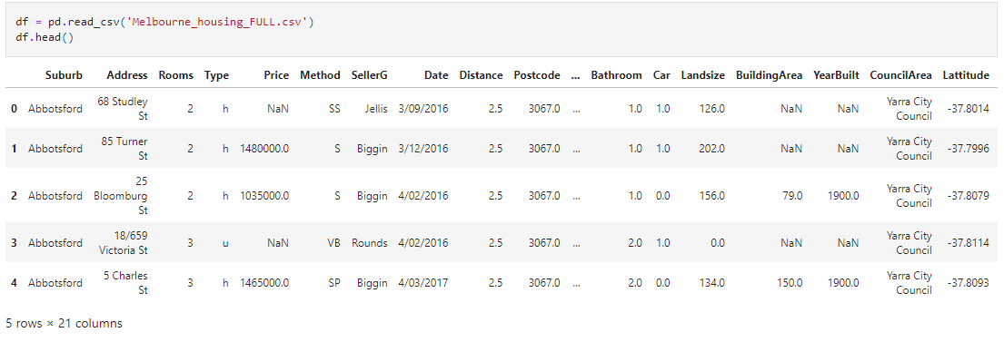
Import Dataset

Slide 6
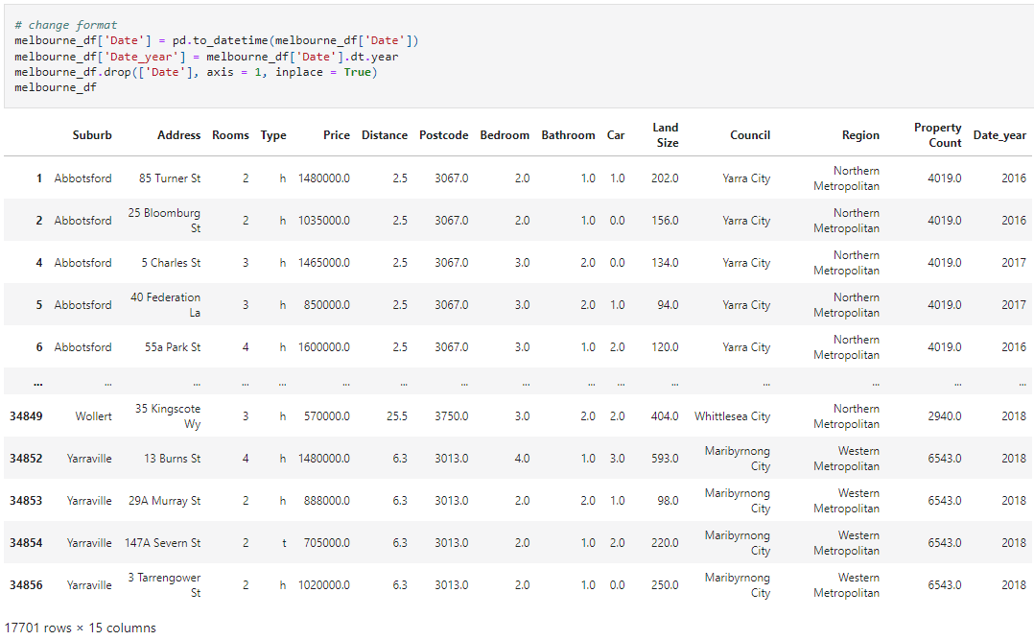
Data Cleaning

Slide 7
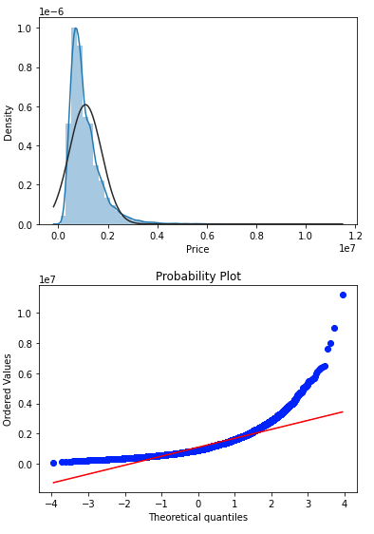
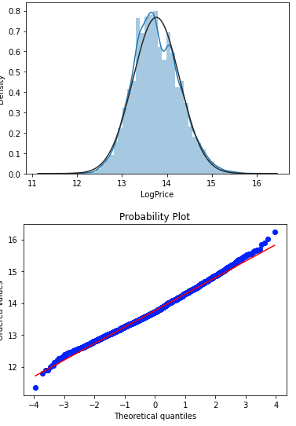
Normality Check
histogram and probability plot with normally distributed
histogram and probability plot after transforming that with np.log()

Slide 8
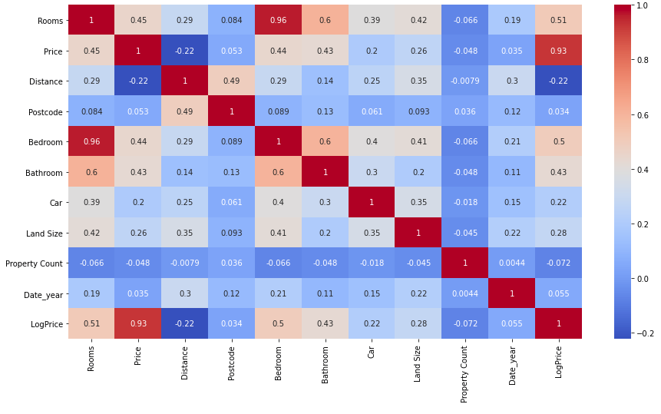
Heatmap
Based on the heatmap, dropping of some columns are needed. [Postcode, year, Land Size, Property count]
Heatmap

Slide 9
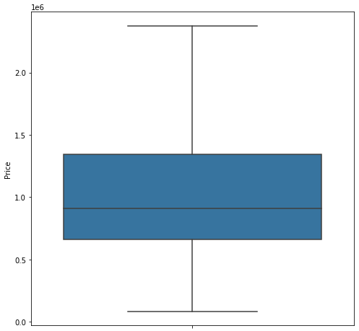
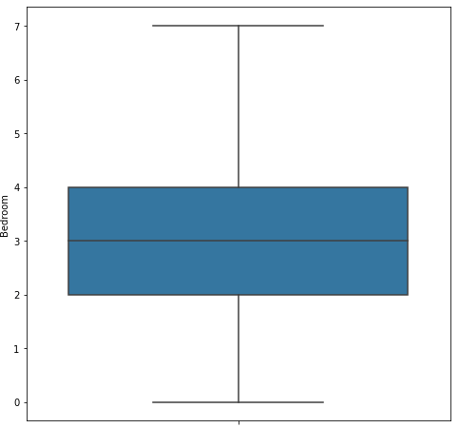
Outliers
Price Boxplot
room Boxplot

Slide 10

Outliers
Bathroom Boxplot

Slide 11
Data Visualization

Slide 12
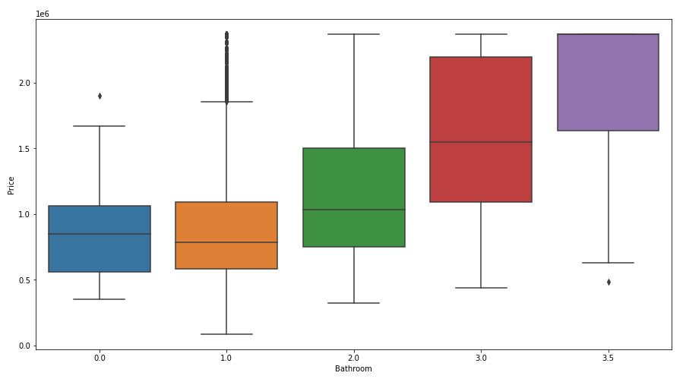
Relationships
Bathroom VS Price

Slide 13
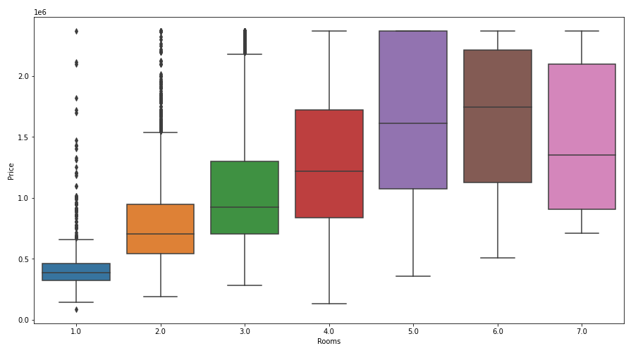
Relationships
Rooms VS Price

Slide 14
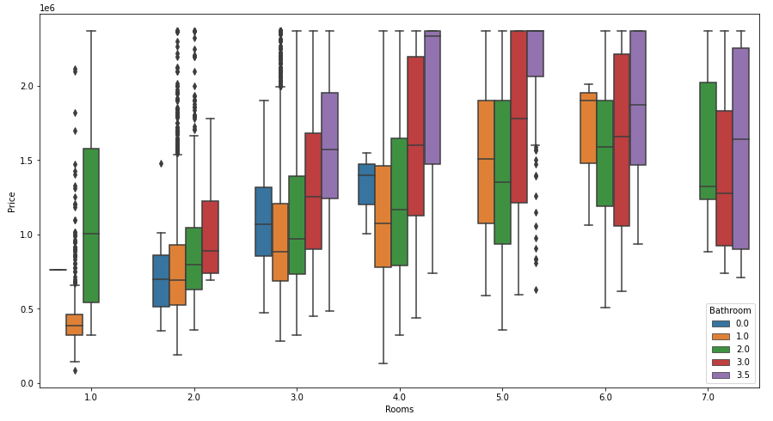
Relationships
Rooms, Bathroom VS Price

Slide 15
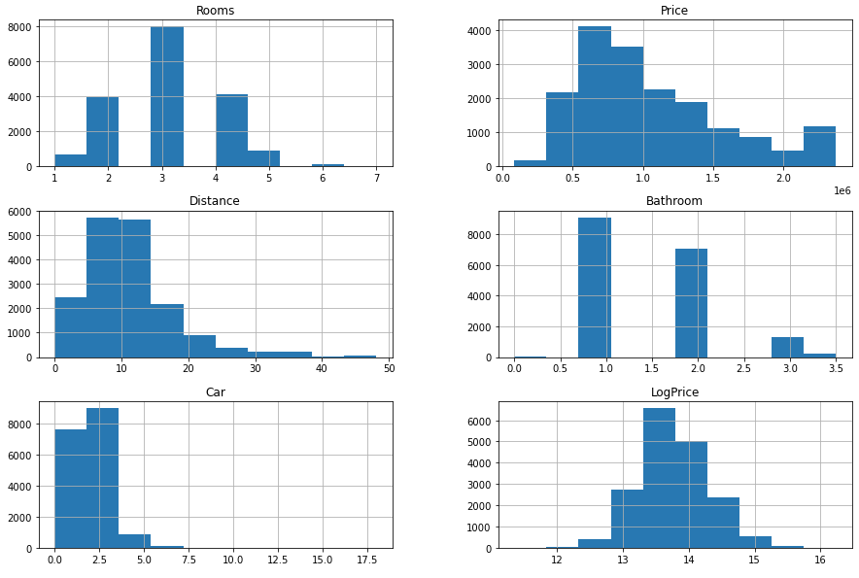
Relationships
Plot each numerical attribute

Slide 16
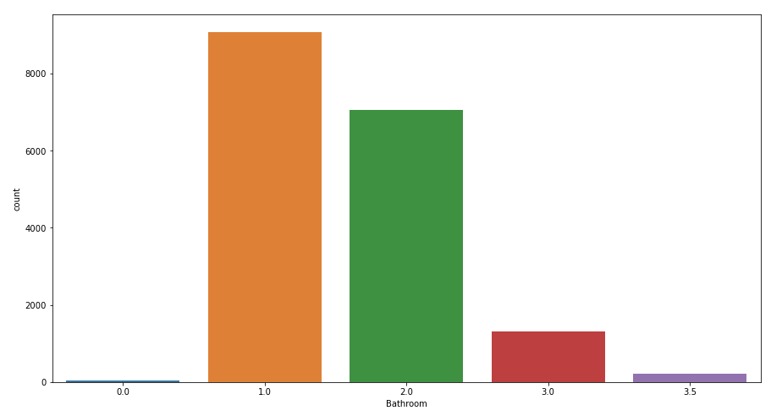
Relationships
Countplots Bathroom

Slide 17
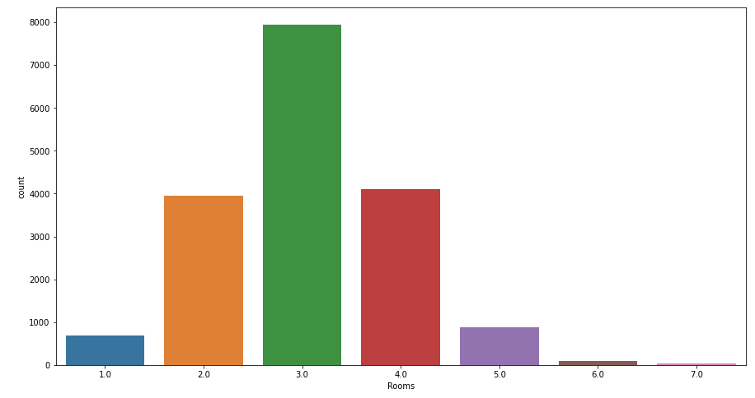
Relationships
CountPlots Rooms

Slide 18
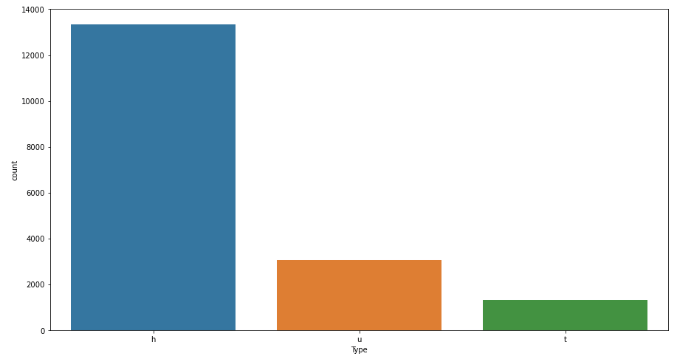
Relationships
CountPlots Type (h : House,villa,cottage,semi,terrace) (u:unit,duplex) (t:townhouse)

Slide 19
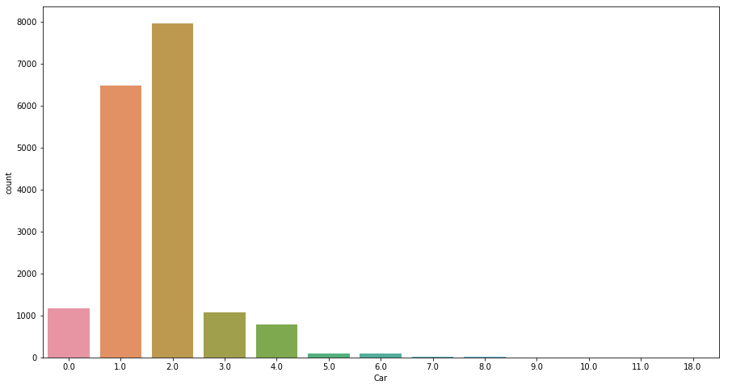
Relationships
CountPlots car

Slide 20
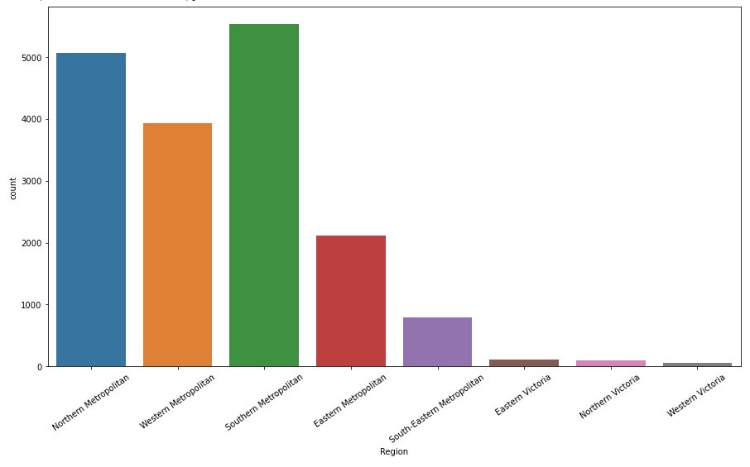
Relationships
CountPlots Region

Slide 21
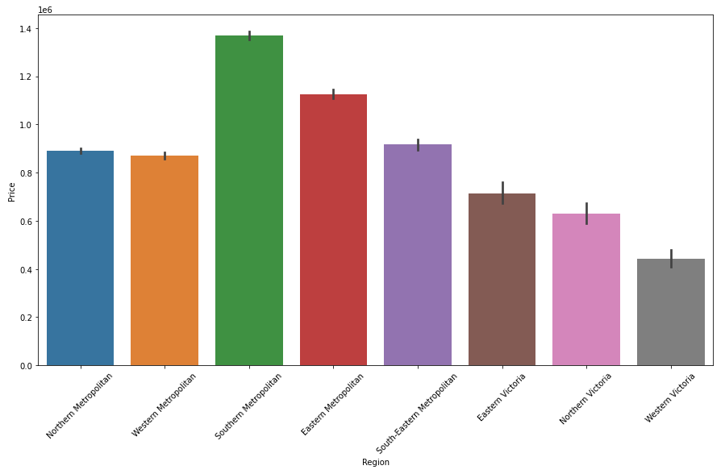
Relationships
CountPlots Region vs Price

Slide 22
Feature Construction
Data Cleaning
Statistical Analysis
Feature Construction
Identifying outliers
Data Conversion
Data Visualization

Slide 23
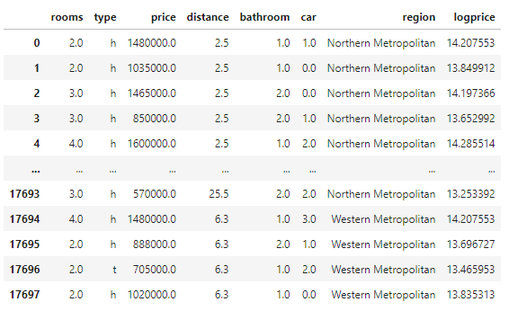
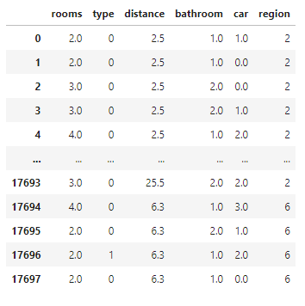
Data Conversion

Slide 24
Model Analysis
Linear Regression Model
Random Forests Model
Decision Tree Model
Randomized Search CV Model
Suppoert vector Regressor
Lasso Model
Ridge Model

Slide 25
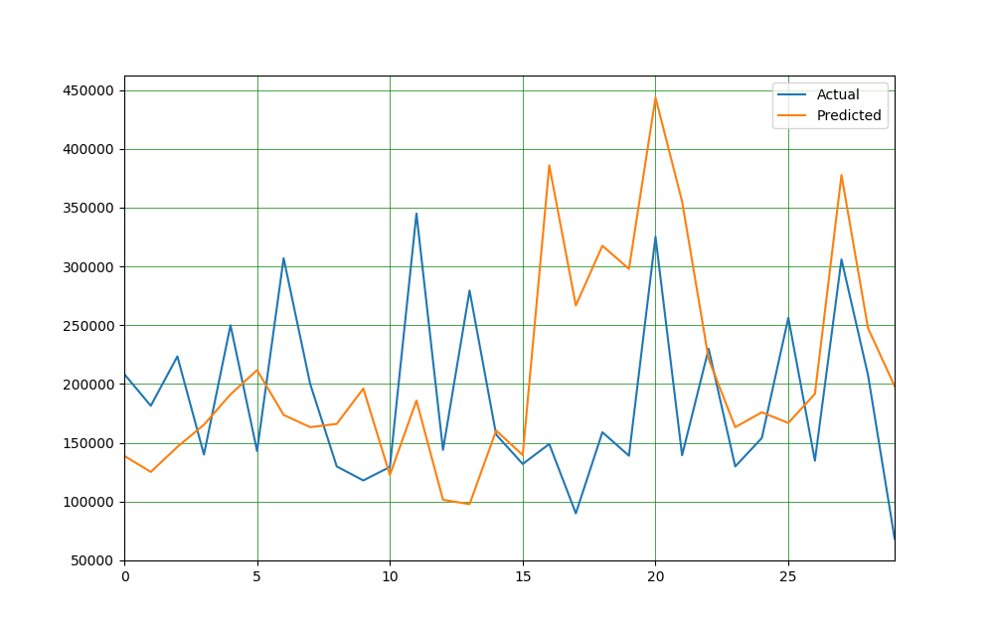

Slide 26
Model Tested
 | train score(R2) | test score
Linear Regression | 0.476343 | 0.461641
Random Forest | 0.297033 | 0.055643
Decision Tree | 0.893777 | 0.712371
Randomized Search CV model | -128442183255.74026 | -126698883394.39828
Support Vector Regressor | -0.072771 | -0.073329
Lasso Model | 0.4763433 | 0.4616413
Ridge Model | -0.297450 | -0.300917

Slide 27
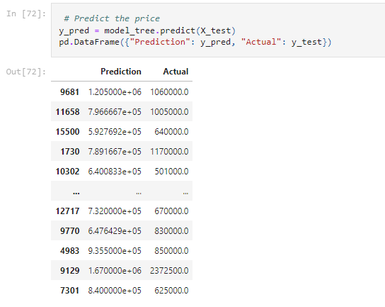
Decision Tree Model
Decision Tree Model Was Selected For Prediction Among All the Reviewed Models
 | train score(R2) | test score
Decision Tree | 0.893777 | 0.712371

Slide 28
Thank You That's All.

